Slide 1

C Fundamentals
HK Rana

Slide 2

Writing a Simple Program
Print a message, “To C, or not to C: that is the question.”

Slide 3
Comments
- Why Important?
- Comment using “//”
- Comment using “/* */”

Slide 4
Variables
- Why we need variables?
- Types of data or data types
- Why we have to declare variables?
- Value assignment to a variable
- Value initializing to a variable
** Printing variable values **

Slide 5
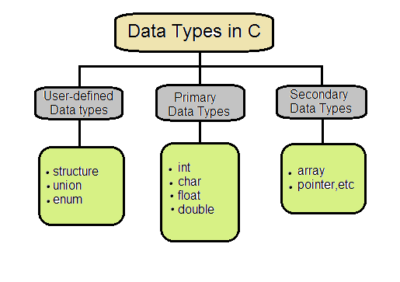
Data Types in C

Slide 6
Rules for naming variables:
A valid variable can have letters (both uppercase and lowercase letters), digits and underscores.
The first letter of a variable should be either a letter or an underscore.
You cannot use keywords as variable.
Blank spaces are not allowed within a variable.
Variable should not be of length more than 31 characters.

Slide 7
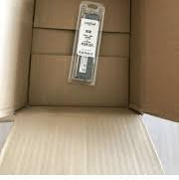

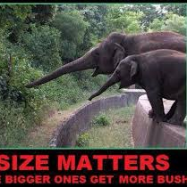
Size is matter for a variable.

Slide 8
Specifier , Size and Range of Data Types:
Type | Format Specifier | Storage size (bits) | Value range
char | %c | 8 | -128 to 127
unsigned char | %uc | 8 | 0 to 255
int | %d or %i | 16 | -32,768 to 32,767
unsigned int | %ud | 16 | 0 to 65,535
long int | %ld | 32 | -2,147,483,648 to 2,147,483,647
unsigned long | %uld | 32 | 0 to 4,294,967,295
float | %f | 32 | 3.4E-38 to 3.4E+38
double | %lf | 64 | 1.7E-308 to 1.7E+308

Slide 9
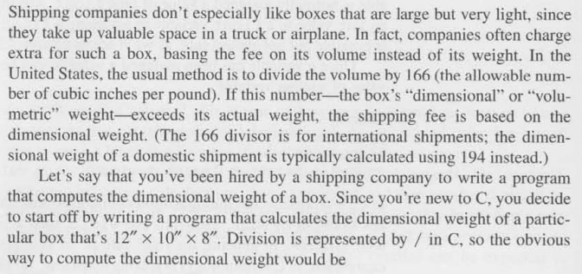

A Sample Program

Slide 10
Reading input from user
- Scanf function
- Defining names of constants

Slide 11
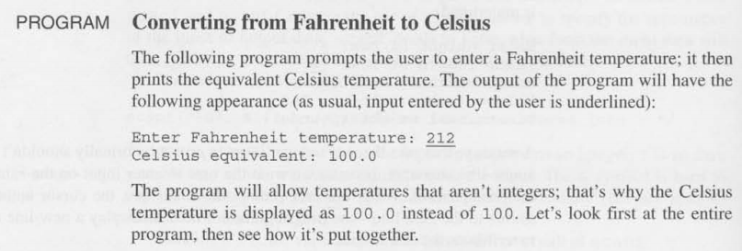

Another Example

Slide 12
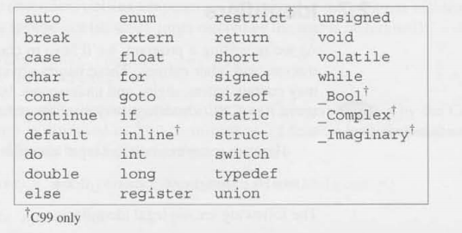
Others
- Identifiers
- Keywords

Slide 13

Reading Assignment
Chapter 3
If you have any query on Chapter 3, ask during the next class.

Slide 14
THE END

